Slide 1
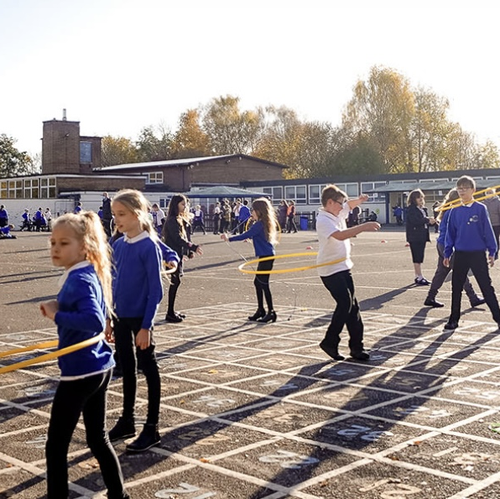

Year 3 Open Evenings
Be Responsible. Be a Learner. Be Respectable. Be Safe.
Thursday 27th November 4-5pm
Monday 1st December 4-5pm
We would like to invite you to meet our staff and tour our school.

