Slide 1
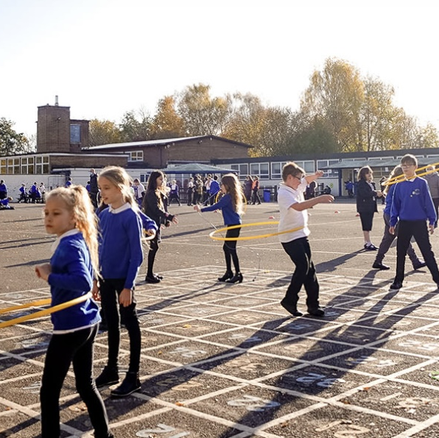

Weston Park Primary - Open Days
Thursday 1st October 3.30pm - 4.15pm - All welcome
Tuesday 6th October 9.15am - 9.45am - Parent/Carers only
    11.00am -11.30am - Parent/Carers only
1.15pm - 1.45pm - Parent/Carers only
Tuesday 13th October 3.30pm - 4.15pm - All welcome
Wednesday 21st October 9.15am - 9.45am - Parent/Carers only
11.00am -11.30am - Parent/Carers only
1.15pm - 1.45pm - Parent/Carers only
Thursday 5th November 9.15am - 9.45am - Parent/Carers only
11.00am -11.30am - Parent/Carers only
1.15pm - 1.45pm - Parent/Carers only
Early Years Strong standard: ‘Children flourish in Early Years.’
‘Pupils behaviour is exemplary.’
Ofsted 2026
Be Responsible. Be a Learner. Be Respectable. Be Safe.

